Slide 1
Carroll County Fire and EMS Department
"Direct to Triage Program"
November 1, 2021
Notes:
Welcome to the Direct to Triage Program presentation.

Slide 2
Objectives
Understand why this program was created and it's capabilities and limitations.
Understand who is appropriate for the program, and how to execute it safely and effectively
Understand the importance of a thorough and accurate assessment to ensure patients are triaged appropriately.
Understand the importance of documentation in this program.
Notes:
This presentation will explain the purpose of the Direct to Triage program as well as it's capabilities and limitations, guide clinicians to determine what patients are appropriate for the program, help clinicians understand the importance of a thorough and accurate assessment as well as the importance of documentation.

Slide 4
Why Direct to Triage?
"Direct to Triage" empowers clinicians to help guide patients with low acuity complaints and stable clinical findings to the receiving hospital's waiting room.
In considering a patient's ability to participate in this program, they have to meet the following criteria before moving forward:
Low acuity/Priority 3 patient
Patient is 18 years or older
Able to communicate with EMS & alert and oriented
Understands the process and clinically sober
Ability to sit independently in a chair or wheelchair
Notes:
The Direct to Triage program will assist the clinician in making the decision to place their patient directly in the receiving hospital's waiting room. Patients must be deemed a low-acuity, Priority 3 patient, be 18 years of age or older, be alert and oriented and able to communicate with EMS, Understand the process of being placed in the waiting room and clinically sober, and able to sit independently in a chair or wheelchair.

Slide 5
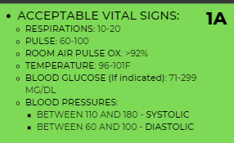
Vital Signs
Are the patient's vital signs acceptable?
This program is designed to identify VERY low risk patients, where we have the ability to remove the extra burden from the ambulance hallway. Acceptable vital signs can be found in chart 1A.
Notes:
Once the patient has met the criteria, the clinician must ensure the patients vitals signs are acceptable. The patient must have a respiratory rate between 10-20, a heart rate between 60-100, a room air pulse ox greater than 92%, a temperature between 96-101 degrees F, A blood glucose level between 71-299 mg/dl, ad blood pressure readings between 1100 and 180 systolic and 60-100 diastolic. Keep in mind, a blood glucose only needs to be measured if it is indicated for that particular patient. It is not a requirement of the program.

Slide 6
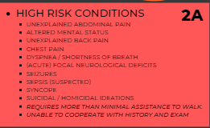
High Risk Conditions
Does the patient have any high-risk conditions present?
High risk conditions must be ruled out. While the list is extensive, it's important clinicians rule out these conditions in order to ensure patients with these conditions are not taken directly to triage by EMS. A list of High-Risk Conditions can be found in chart 2A.
Notes:
Patients with high-risk condition are automatically excluded from the Direct to Triage Program and must be taken through the ambulance entrance of the emergency room. High risk conditions include:
Unexplained abdominal pain
Altered mental status
Unexplained back pain
Chest pain
dyspnea or shortness of breath,
acute focal neurological deficits, seizures, suspected sepsis, syncope, suicidal or homicidal ideations, patients requiring more than normal assistance to walk, or patients unable to cooperate with a history and physical exam.

Slide 7
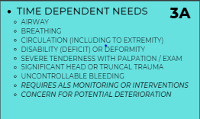
Time Dependent Needs
Does the patient have any time dependent needs?
When triaging patients in this program time dependent needs must be ruled out. Time dependent needs can be found in chart 3A.
Notes:
Patients who have time dependent needs will be excluded from the direct to triage program and taken through the ambulance entrance. Time dependent needs include:
Airway, breathing or circulation issues that require immediate attention, New onset deficits or deformities, Severe tenderness with palpation or on exam, significant head or truncal trauma, uncontrollable bleeding, patients who require ALS monitoring or interventions, or any patient with the concern for potential deterioration.

Slide 8
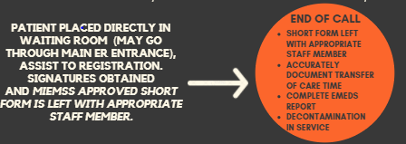
Direct to Triage Procedure
IF the patient meets all the criteria, the patient is moved directly to the waiting room via wheelchair and assisted to registration. The clinician will obtain signatures and leave the MIEMSS approved short form with the appropriate staff member.
Note: Patients not initially destined for "Direct to Triage" can still be taken to the waiting room if directed to do so by the Charge RN or their designee.
Notes:
Once the clinician determines the patient has met the criteria for the Direct to Triage Program to include acceptable vital signs and the absence of high risk conditions or time dependent needs, the clinician will assist the patient to the waiting room triage area to be registered. The clinician will obtain signatures from the patient as well as hospital staff while providing a brief report to the triage nurse in the waiting room. The clinician must provide the triage nurse with the MIEMSS approved short form prior to clearing the hospital.
Patients who are not initially destined for Direct to Triage can still be taken to the waiting room if directed to do so by the Charge Nurse.

Slide 9
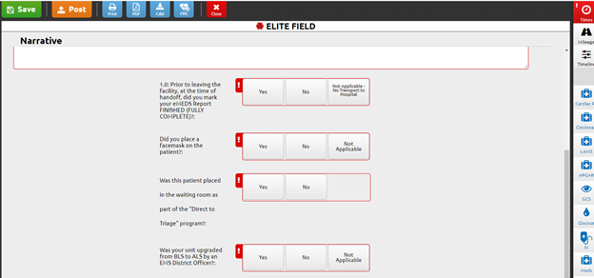
Documentation
Jurisdictional question:
Clinicians will be required to answer the jurisdictional question found in the Narrative section of the eMEDS report.
"Was this patient placed in the waiting room as part of the "Direct to Triage" program? (Yes/No)
Notes:
When completing the eMEDS report, clinicians will be required to complete the Jurisdiction question located beneath the narrative.

Slide 10
100%
All eMEDS reports of patients identified as participating in the Direct to Triage Program will require review.
Quality Assurance/
Improvement
Feedback
Clinicians will be provided with feedback through the QA/QI function in eMEDS.
Notes:
All eMEDS reports identified as participating in the Direct to Triage Program will require review. Clinicians will be provided with feedback through the QA/QI function in eMEDS.

Slide 11
Frequently Asked Questions
Does every patient really require a BGL check?
No- However, the clinician should ensure compliance with the Maryland Medical Protocols pertaining to acquisition of a blood glucose level. A thorough assessment should always be performed, and good clinical judgement used.
What do I do if a hospital is on alert status/re-route?
Does every patient require a temperature to be taken?
IF you have a patient that meets the "Direct to Triage" program criteria, transport the patient to the closest appropriate hospital regardless of the hospital's status.
No- The clinician should obtain a temperature on patient populations that are considered especially high risk for sepsis and those who meet PUI criteria.
Notes:
The EMS Office understands that questions about the program will arise. Questions regarding the direct to triage program should be directed to your departmental EMS Officers. Here are a few questions that you may already have.

Slide 12
Temperature Measurement
Patients meeting sepsis or PUI criteria must have a temperature taken.
Notes:
Temperature measurement is not required for each patient. Clinicians should use judgement when obtaining a temperature measurement to determine if it is appropriate. Patients who meet sepsis or PUI criteria must have a temperature taken.

Slide 13
Direct to Triage at Carroll Hospital Center
How “Direct to Triage” will work at Carroll Hospital Center, and reduce off load times at Carroll Hospital Center
Units will report to the EMS Bay as normal, and register the patient with Carroll Hospital registration staff
-Units will obtain a full set of vitals on the patient to include: Blood Pressure, Respiratory Rate, Pulse, Pulse Ox Reading and temperature on the patient
Unit will share vital signs with Triage Nurse and advise the Triage Nurse that the patient is a candidate for the “Direct to Triage Program”
Unit will obtain a wheelchair from the ER Main Entrance and move the patient to the wheelchair in the EMS entrance
The patient will be wheeled through the “Intake Area” of the Emergency Room and left in the waiting room at Carroll Hospital Center
Notes:
The Direct to Triage program will assist the clinician in making the decision to place their patient directly in the receiving hospital's waiting room. Patients must be deemed a low-acuity, Priority 3 patient, be 18 years of age or older, be alert and oriented and able to communicate with EMS, Understand the process of being placed in the waiting room and clinically sober, and able to sit independently in a chair or wheel chair.

Slide 14
Direct to Triage at Carroll Hospital Center
How “Direct to Triage” will work at Carroll Hospital Center, and reduce off load times at Carroll Hospital Center
After going through the intake area of the Emergency Room, the clinician will wheel the patient into the waiting room at Carroll Hospital Center
The completed MIEMSS Approve Short Form will be left on the labeled black folder rack that states “Triage”
This folder rack is located by the door between the Emergency Room Waiting Area and the Intake Area
Notes:
The Direct to Triage program will assist the clinician in making the decision to place their patient directly in the receiving hospital's waiting room. Patients must be deemed a low-acuity, Priority 3 patient, be 18 years of age or older, be alert and oriented and able to communicate with EMS, Understand the process of being placed in the waiting room and clinically sober, and able to sit independently in a chair or wheel chair.

Slide 15
Thank you for viewing the "Direct to Triage" program. Please direct all questions regarding the program to your Department’s EMS Officers.
Notes:
Thank you for viewing the Direct to Triage Program. Please direct all questions regarding the program to your EMS District Officer.

